Slide 1
Hello, love.
A website for anyone who needs to take a moment and chill.
Reed Reed

Slide 2
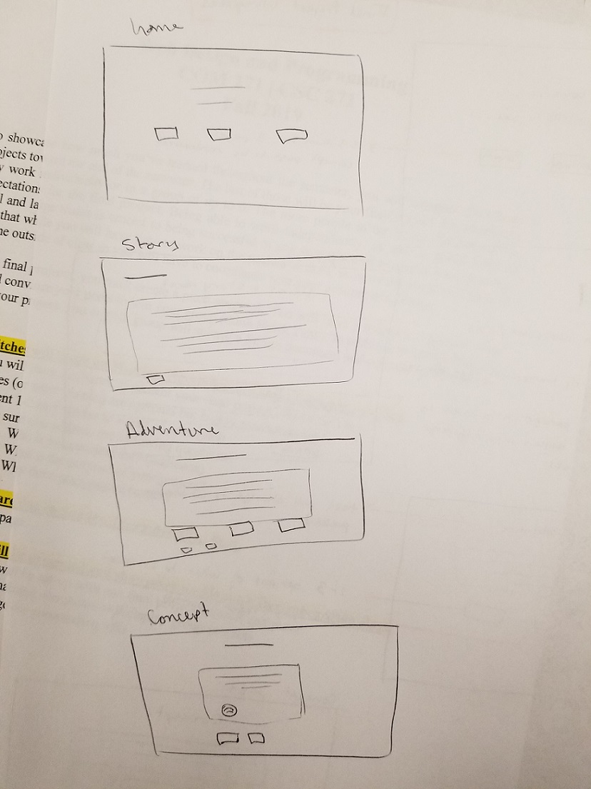
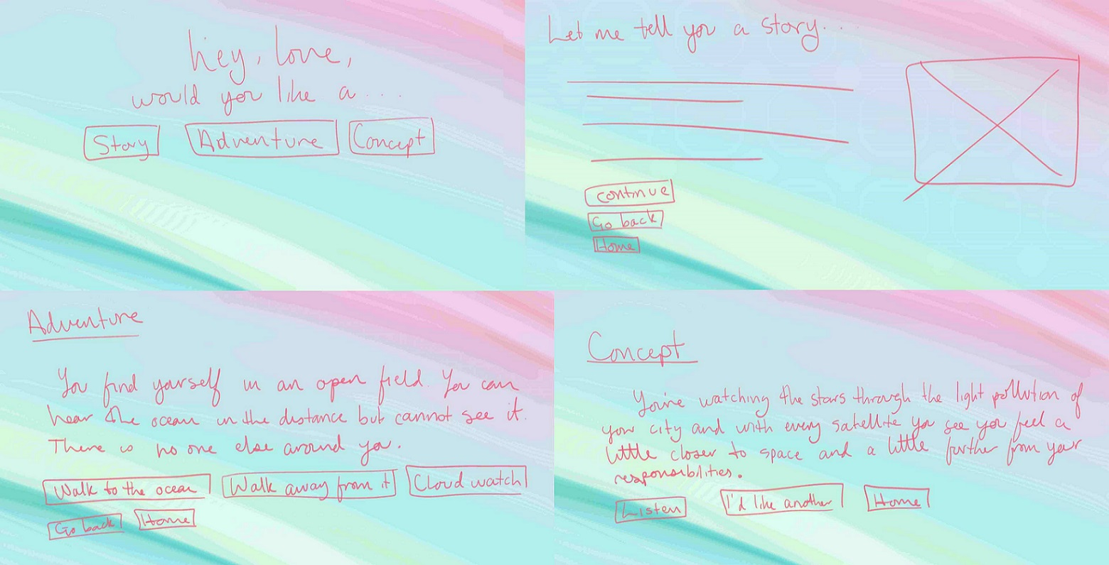

Slide 3
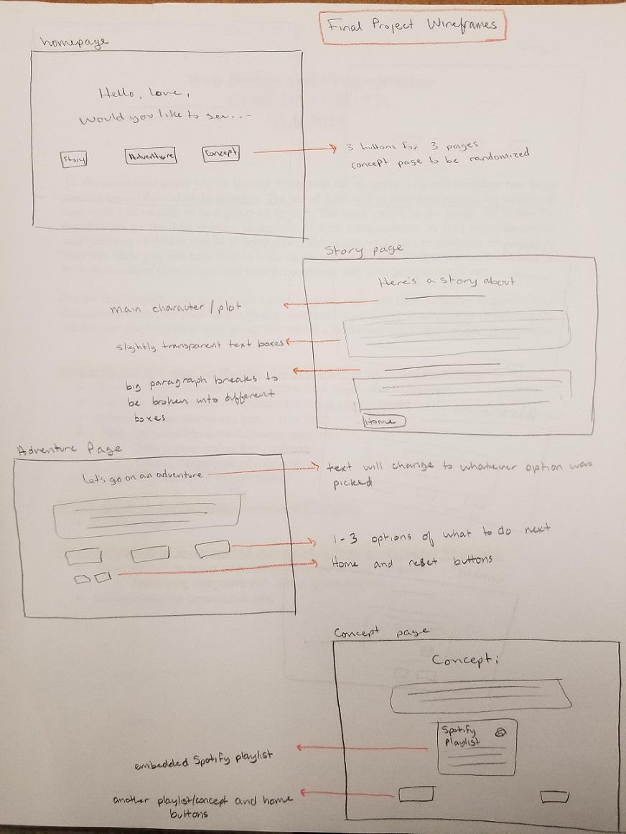

Slide 4
User Stories
As a user I want the site to be aesthetically pleasing but not distracting.
As a user, I want to be able to click through a short adventure and have my choices matter.
As a user, I want to be able to click a button and get a randomized concept with an attached playlist.
As a user, I want to be given a short story at the click of a button.

Slide 5
https://hreed.rhody.dev/final/index.html

